Slide 1
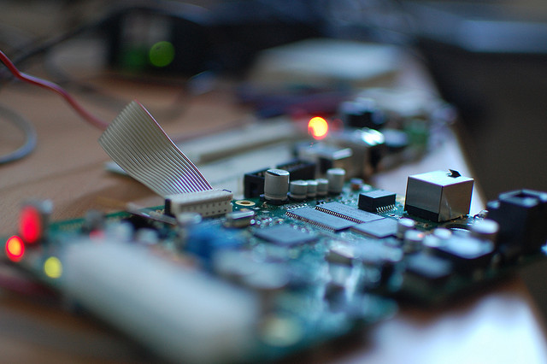
Integrated Modular Centralized Wiegand Emulator
Increase reliability and reduce testing time!

Slide 2
Agenda
Automatic testing system?
CoAP
What is IEAWE?
How it works!
How to create simple test scenario

Slide 3
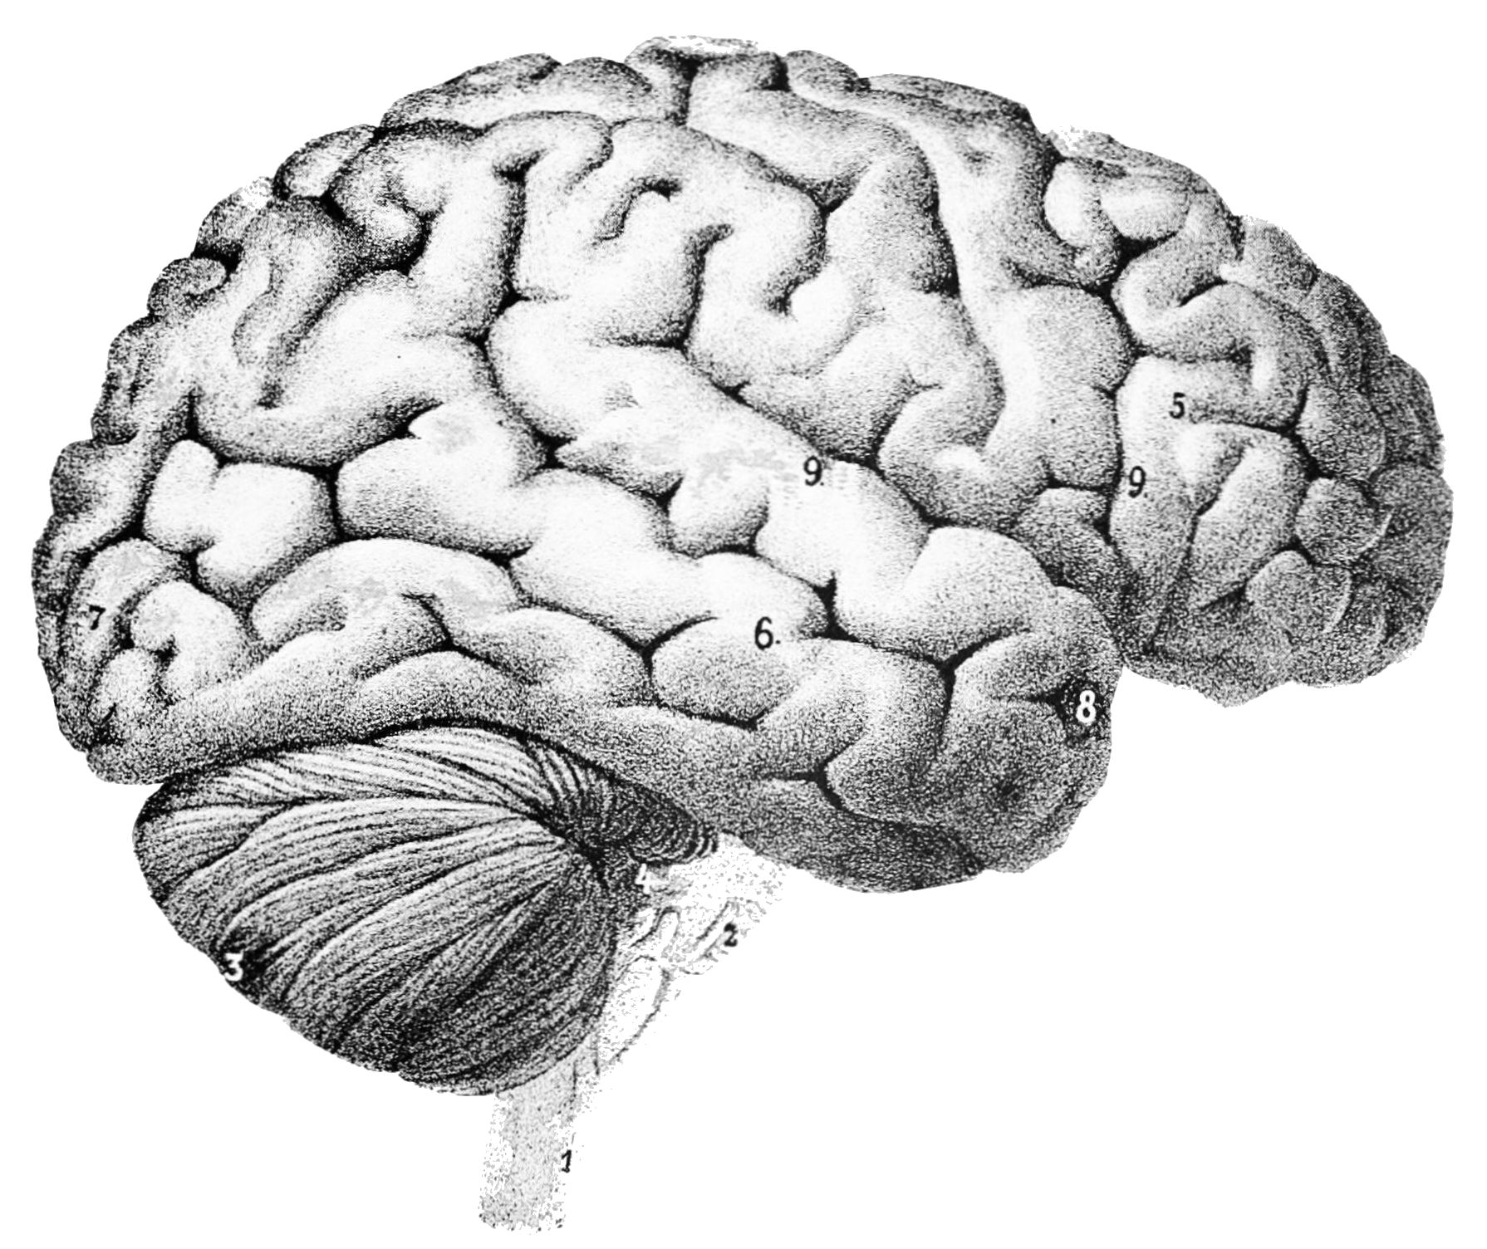
What you will need
Running Weigand card reader System
Extra RJ45 Ethernet cable with
Windows/Linux system.
Collection of CSV text files with card data

Slide 4
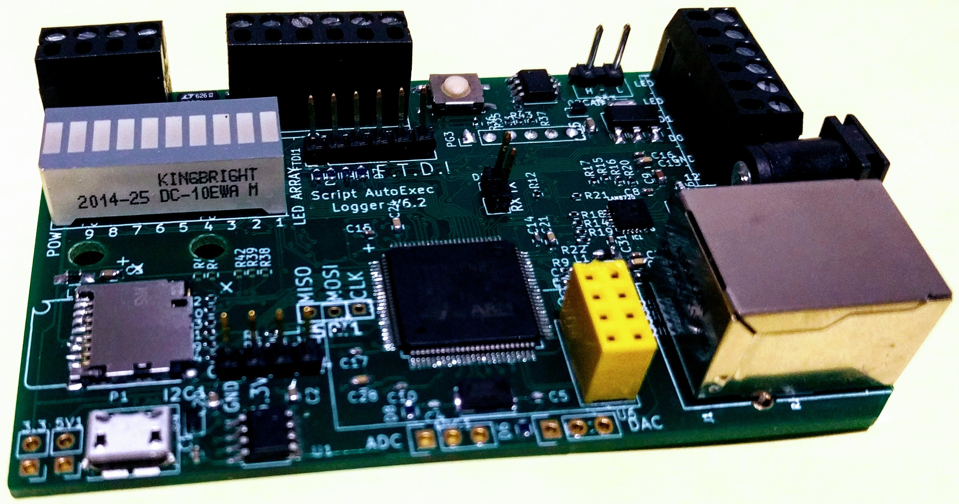
How it woks ?

Slide 5

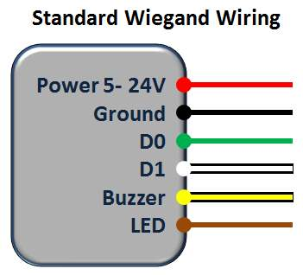
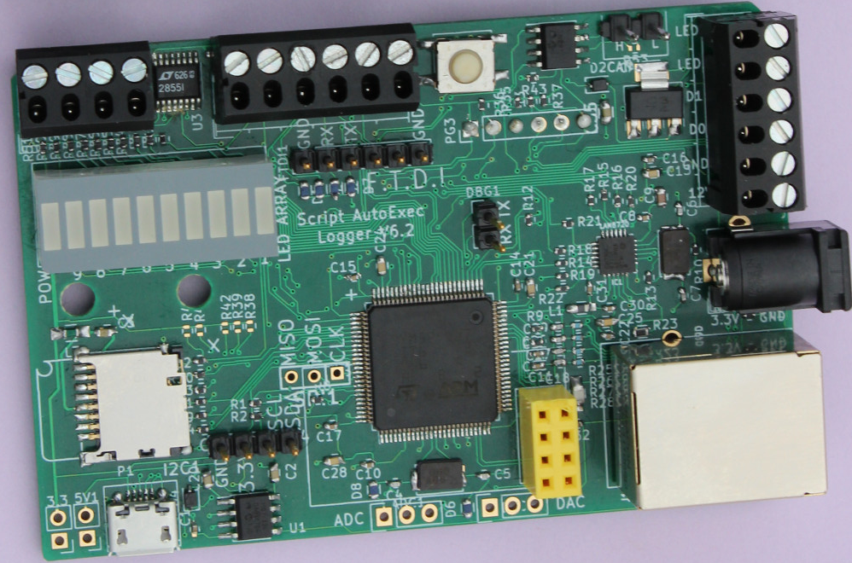
Basic Access Control Emulator Setup
Primary Card Management Host Server
Nth Emulator
1st Emulator
Ethernetnet link
Ethernet Enabled Weignad
Ethernet Enabled Weignad

Slide 6
CSV Controlled setup
Input CSV File
Output CSV File
Weigand Card Format | Card Num
wieg26 | 1,1394
.. ..
wiegraw | 344734
wiegraw | 448556
WiegCrd | CardNum | Result | Time
wieg26 | 1,1396 | success | 50ms
.. .. |  |  | …
wiegraw | 344734 | success | 59ms
wiegraw | 448556 | failure | 49ms
Ethernetnet link
Nth Emulator
1st Emulator
Ethernet Enabled Weignad
Ethernet Enabled Weignad

Slide 7
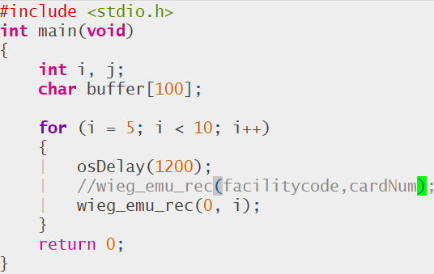
“C” Script Controlled setup
Input Text “C” File (No need to compile, its “C” script)
Output CSV File
WiegCrd | CardNum | Result | Time
wieg26 | 5 | success | 50ms
.. .. |  |  | …
wieg26 | 8 | success | 59ms
wieg26 | 9 | failure | 49ms
Ethernetnet link
Nth Emulator
1st Emulator
Ethernet Enabled Weignad
Ethernet Enabled Weignad

Slide 8
How Successful or Failure/Timering mesaured ?
Timer Start
Wiegnad Emulator Command
Last wiegnad Bit
Granted
Emulator
ProcessingTime
Measurement
Granted/Denied
Door OPEN GREEN LED Blinking TIME
RED LED ON
Access Denied

Slide 9
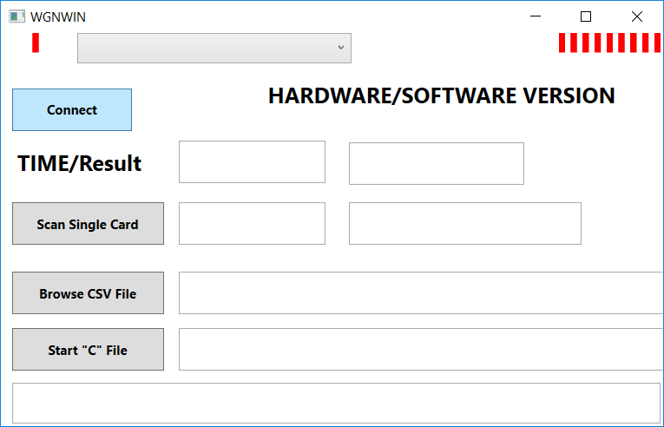
WPF GUI Overview (Open source Only Windows)
Click to Connect (See next slide)

Slide 10
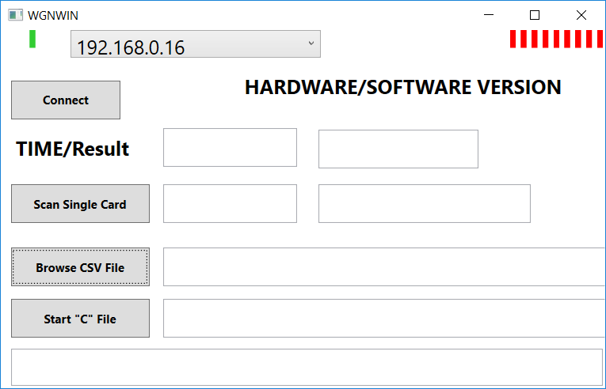
WPF GUI Overview (Open source Windows)
Connected to Hardware

Slide 11
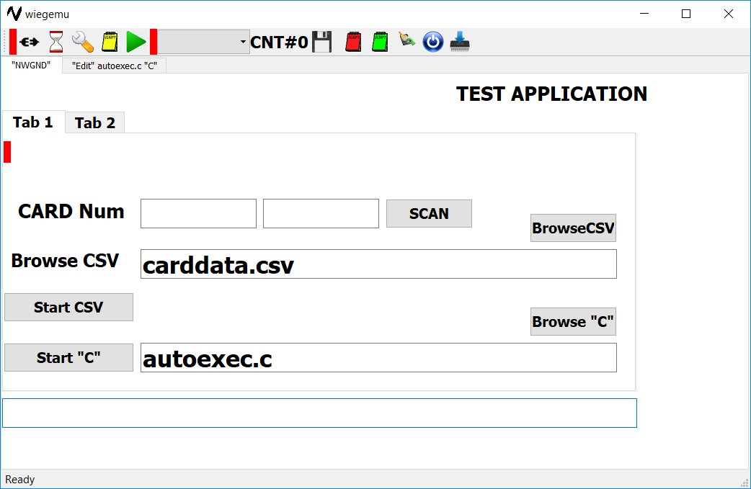
MIT License open source QT GUI Overview (Windows /Linux)

Slide 12
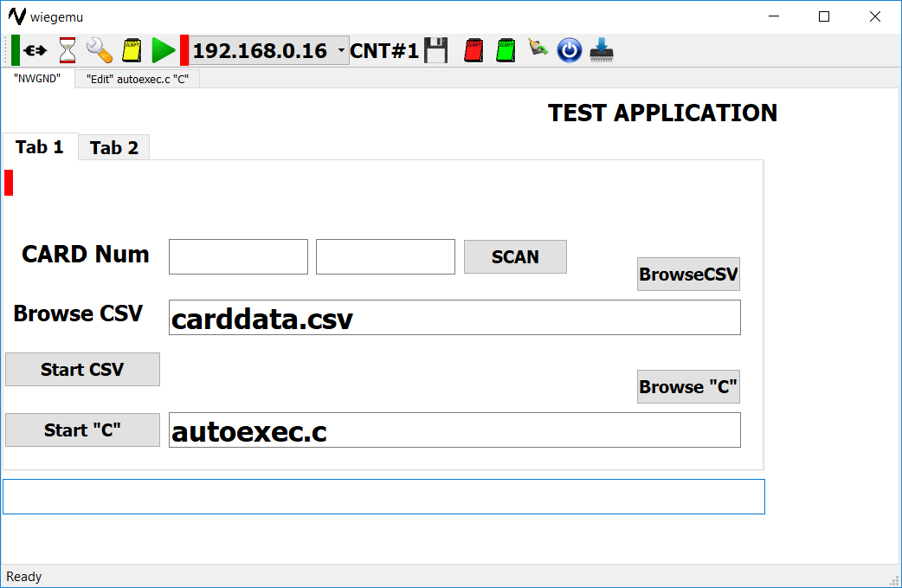
MIT License open source QT GUI Overview (Windows /Linux)

Slide 13
How Emulator connects to HW
Each Wigand emulator obtains IP Address from DHCP server to obtain ipv4 ip address as soon as power is applied and Ethernet link available.
Once obtained IP emulator broadcasts IP Address, once every 10 seconds interval.
PC Application WPF/QT handles broadcast packets to locate each emulator device and establishes communication.
At this point PC Ready to execute instructions to emulate Wigand cards.
All communication takes place of CoAP port 5683 over reliable communication UDP port.

Slide 14
How Emulator connects to HW
Emulator system has built-in Ethernet based bootloader which makes system easy for upgrade or feature enhancement or bug fixing.
All open source application and library including terminal emulator can be found at following location.
https://github.com/natashaiwscope/emulator_v0

Slide 15
How Emulator Works
PC Reads CSV file sends Wiegand card number to emulator device.
Emulator device generates wiegand signal, at end starts precision Timer to measure time.
Emulator keeps an eye for Geeen LED/Red LED transition.
As soon as LED transition happens depending upon GREEN (Access granted)/RED (Access denied).
Emulator posts card number and time to application which sent requests.
PC Application collects packet and creates CSV file for record.

Slide 16
Wiegand Testing
System can send 1000 Wigand requests every second to connected system which enables system to test 1 million swipe over night for load testing.
As it measures precision timing enables user to compare two systems for efficiancy.
Please provide up for feedback and improvments to add additional features.

